Slide 1
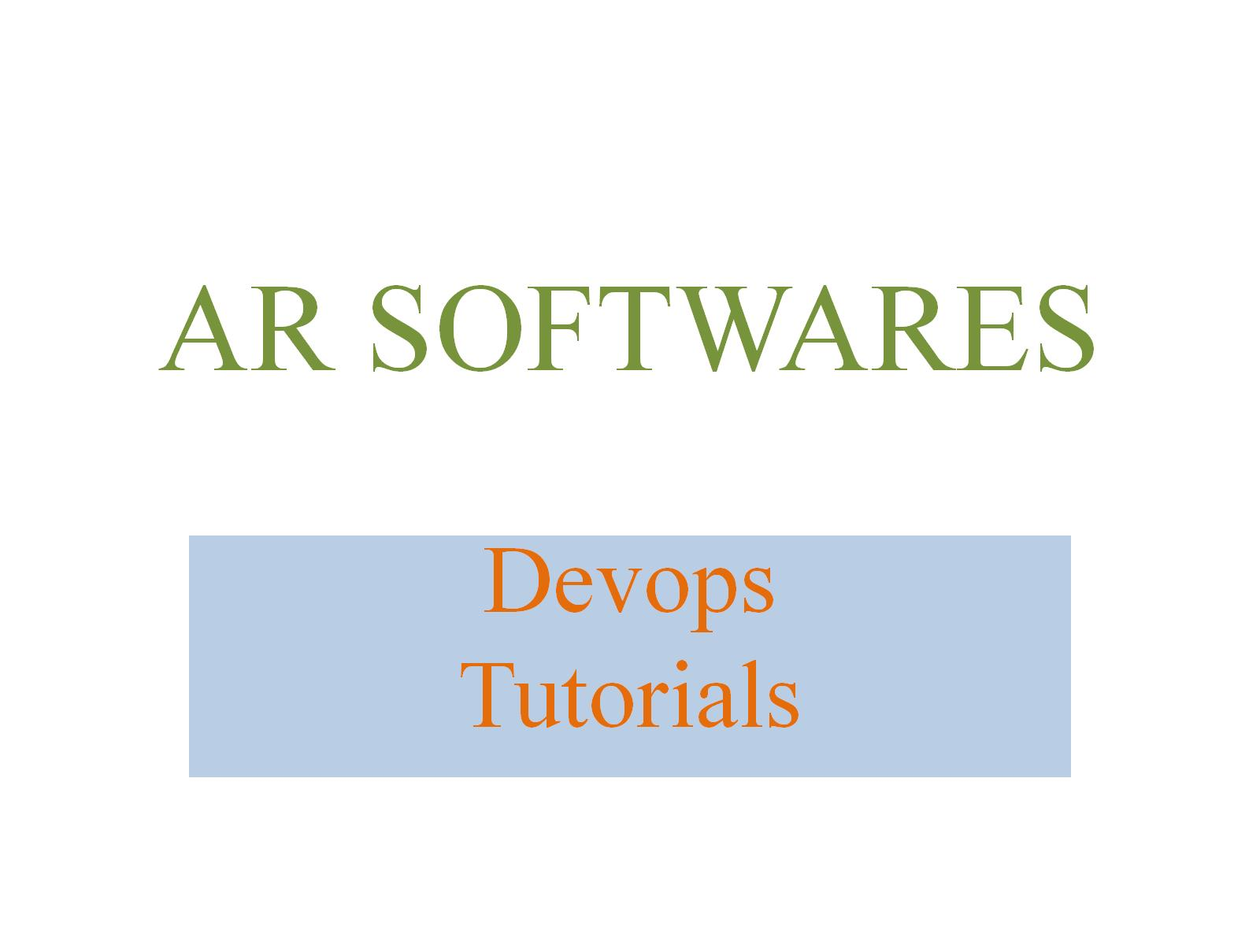
AR SOFTWARES

Slide 2
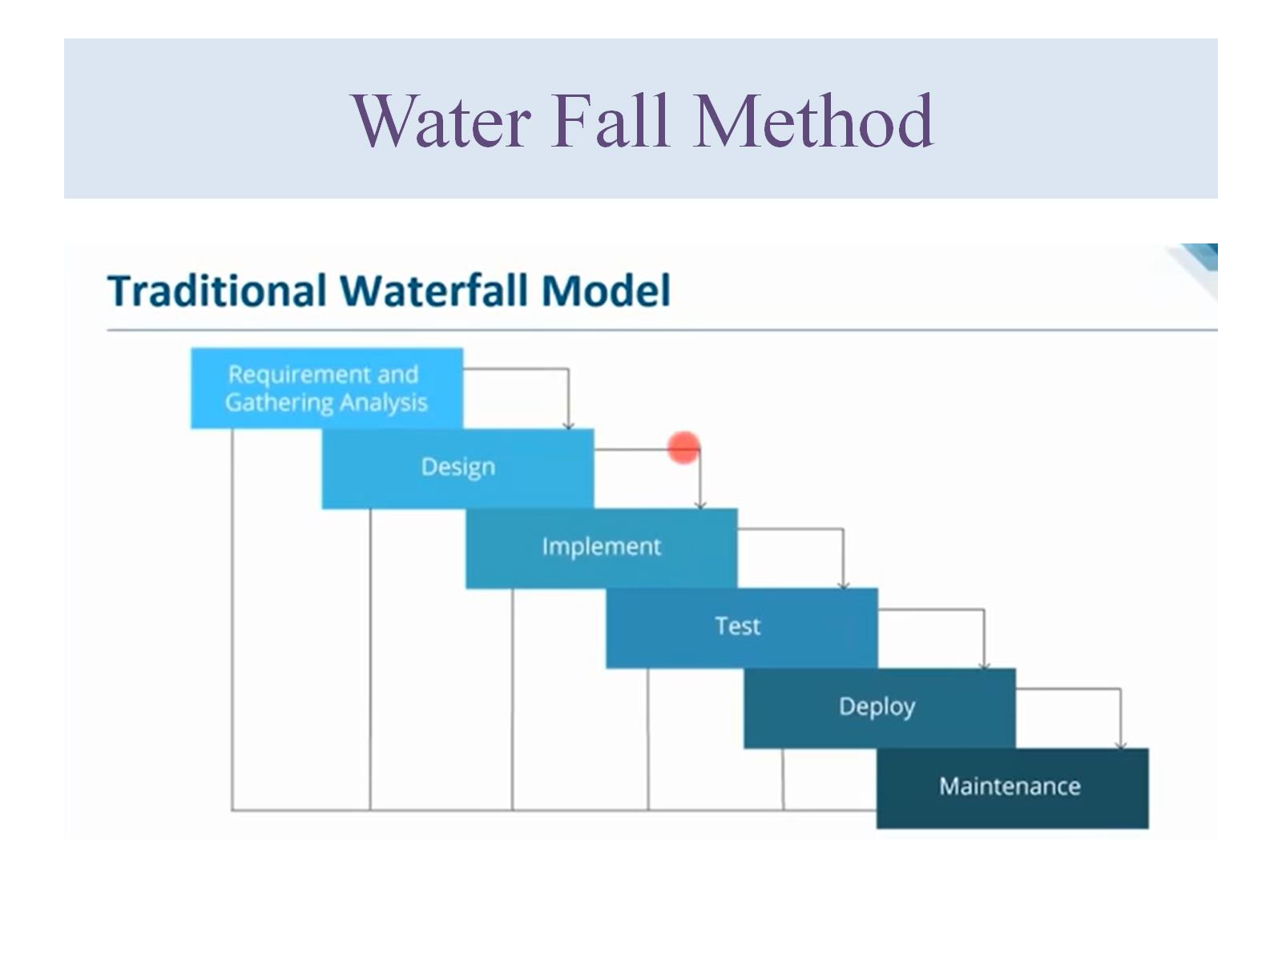
Water Fall Method

Slide 3
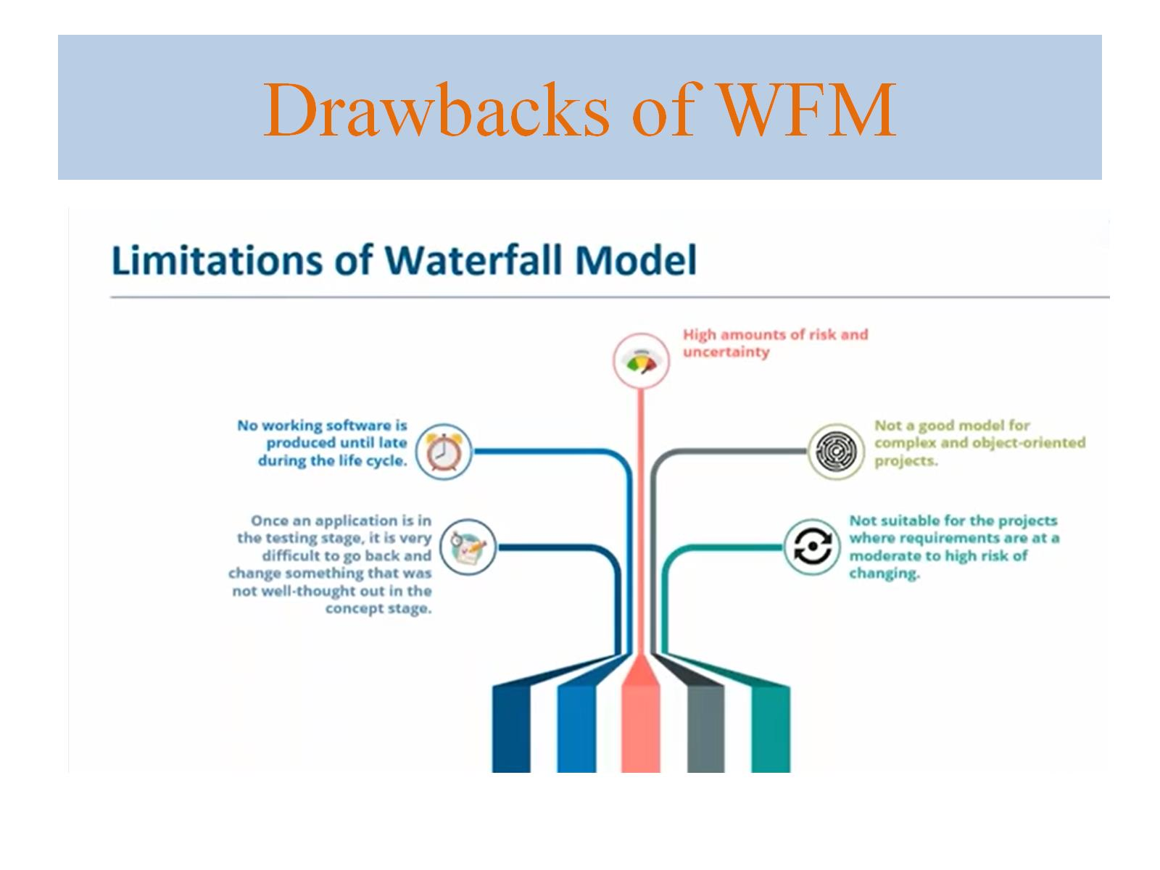
Drawbacks of WFM

Slide 4
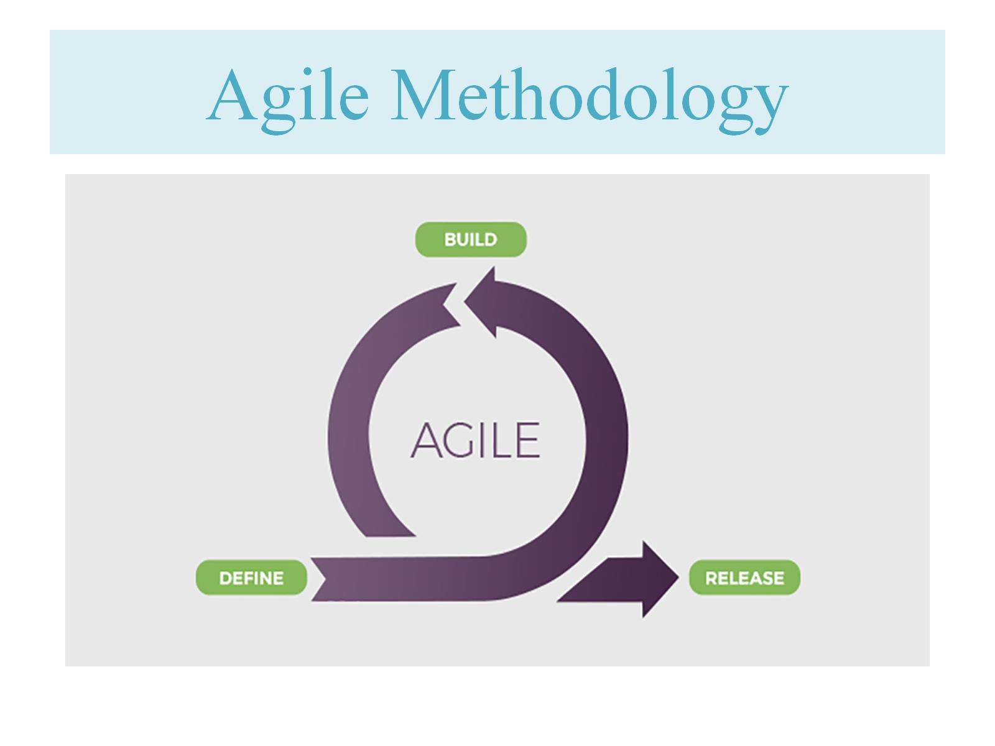
Agile Methodology

Slide 5
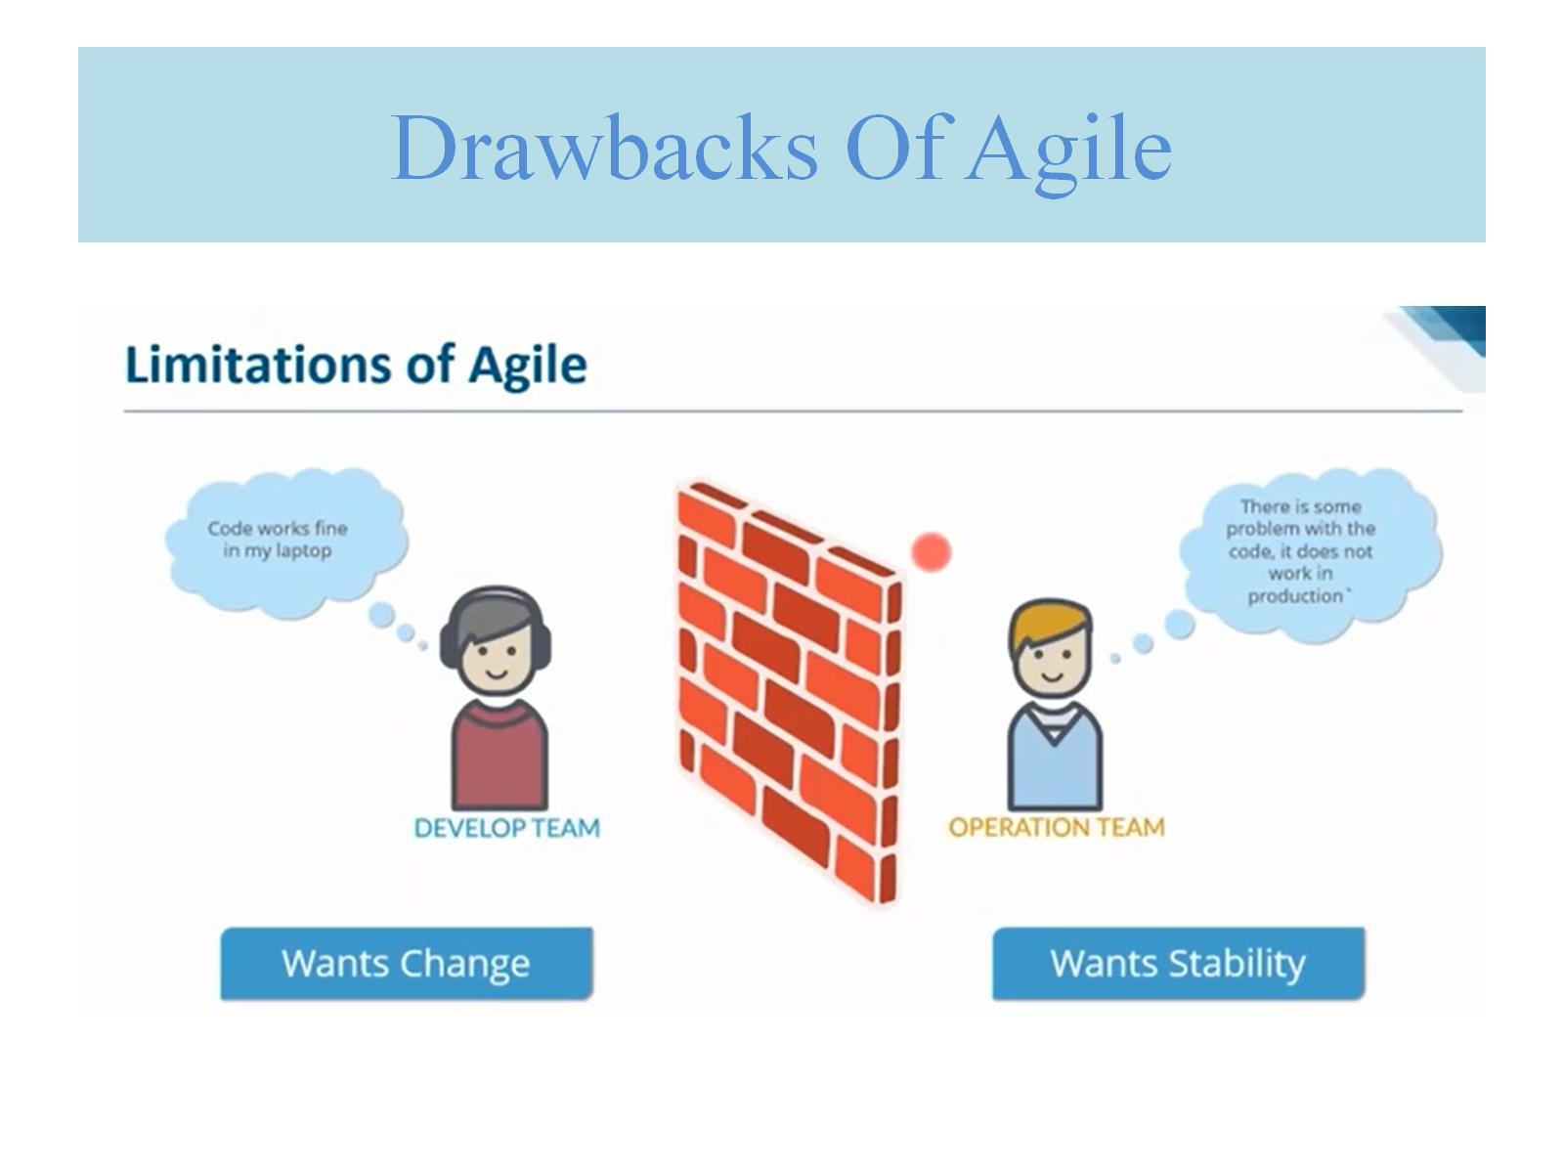
Drawbacks Of Agile

Slide 6
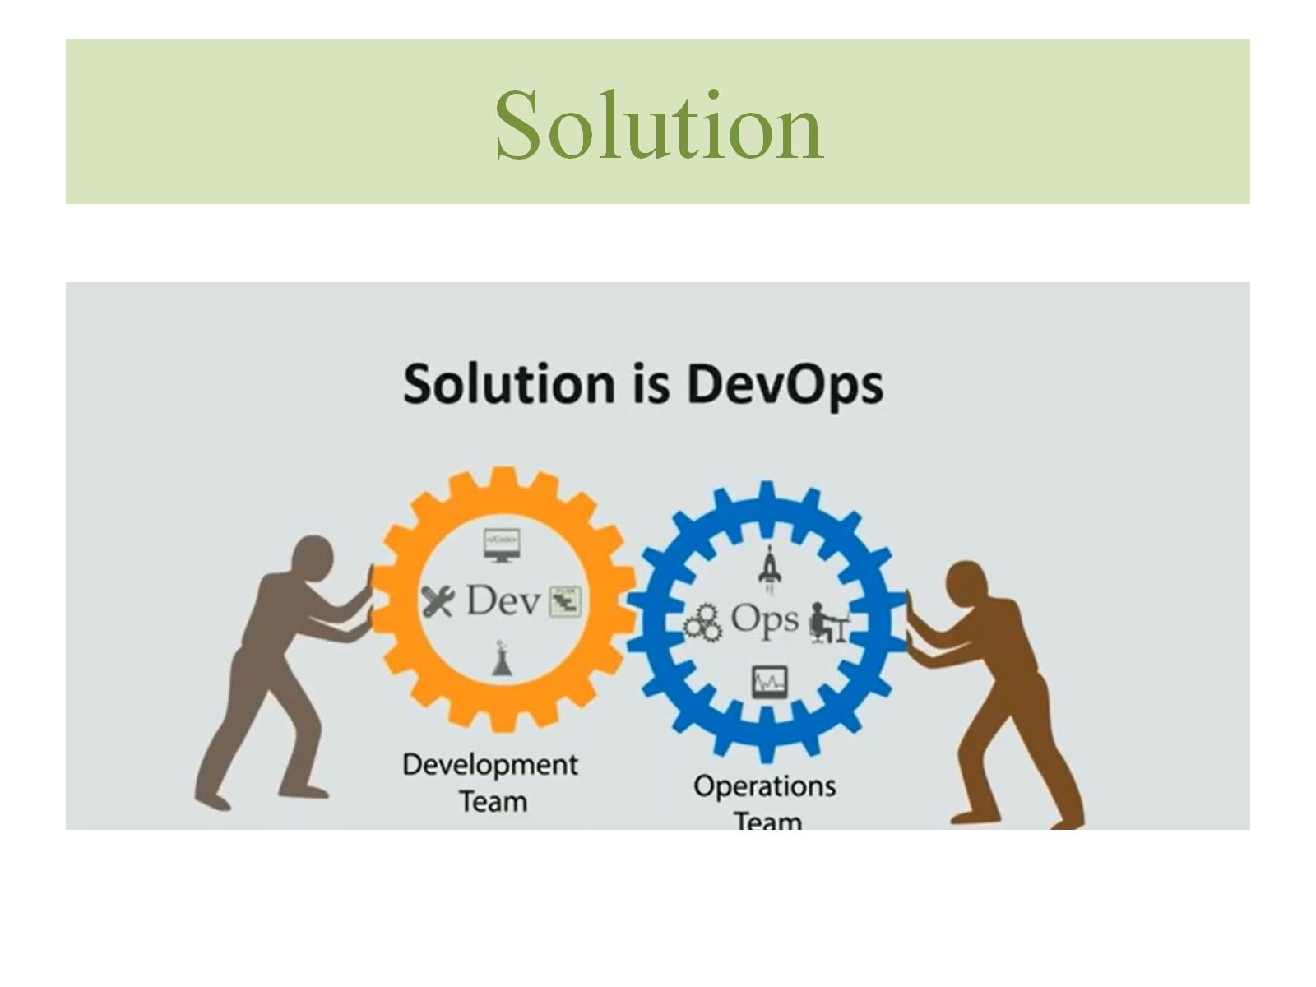
Solution

Slide 7
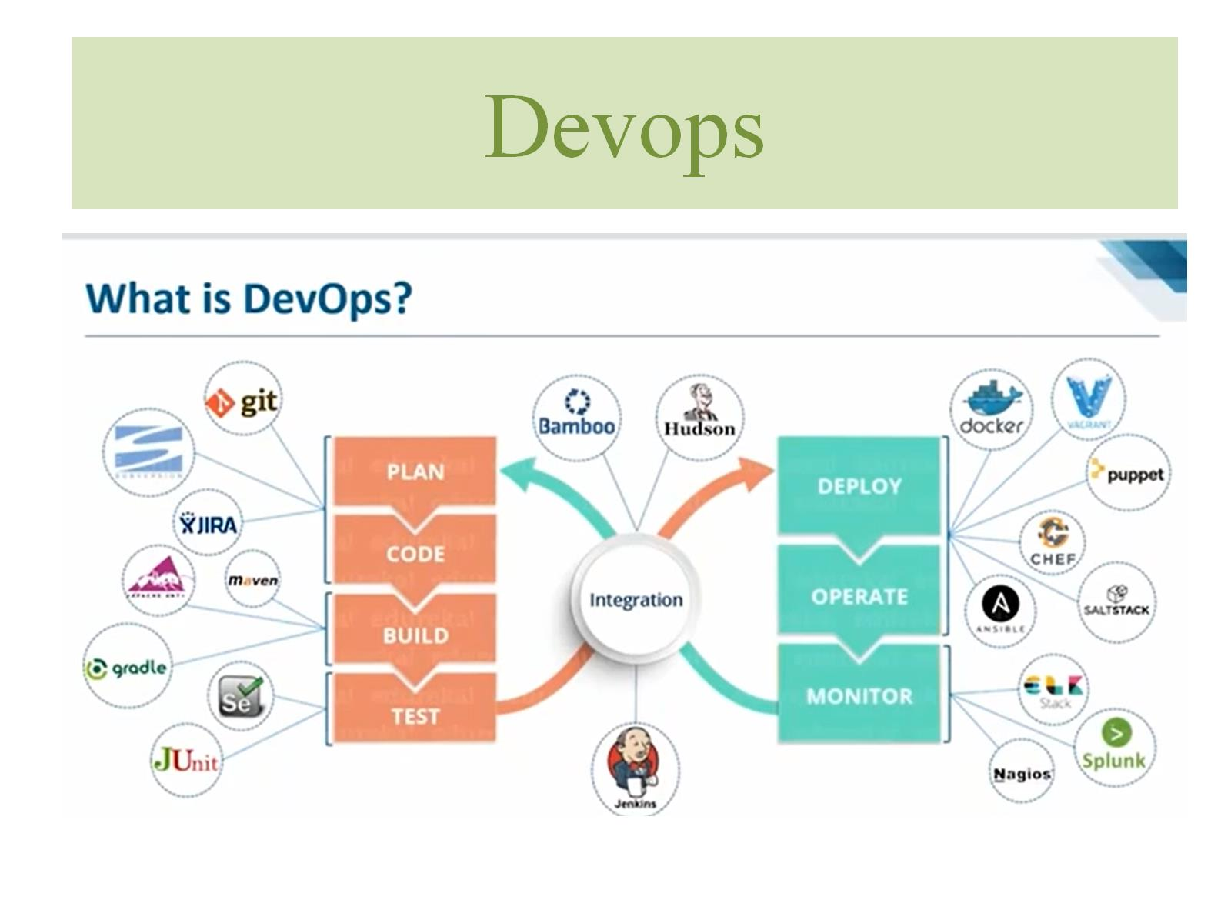
Devops

Slide 8
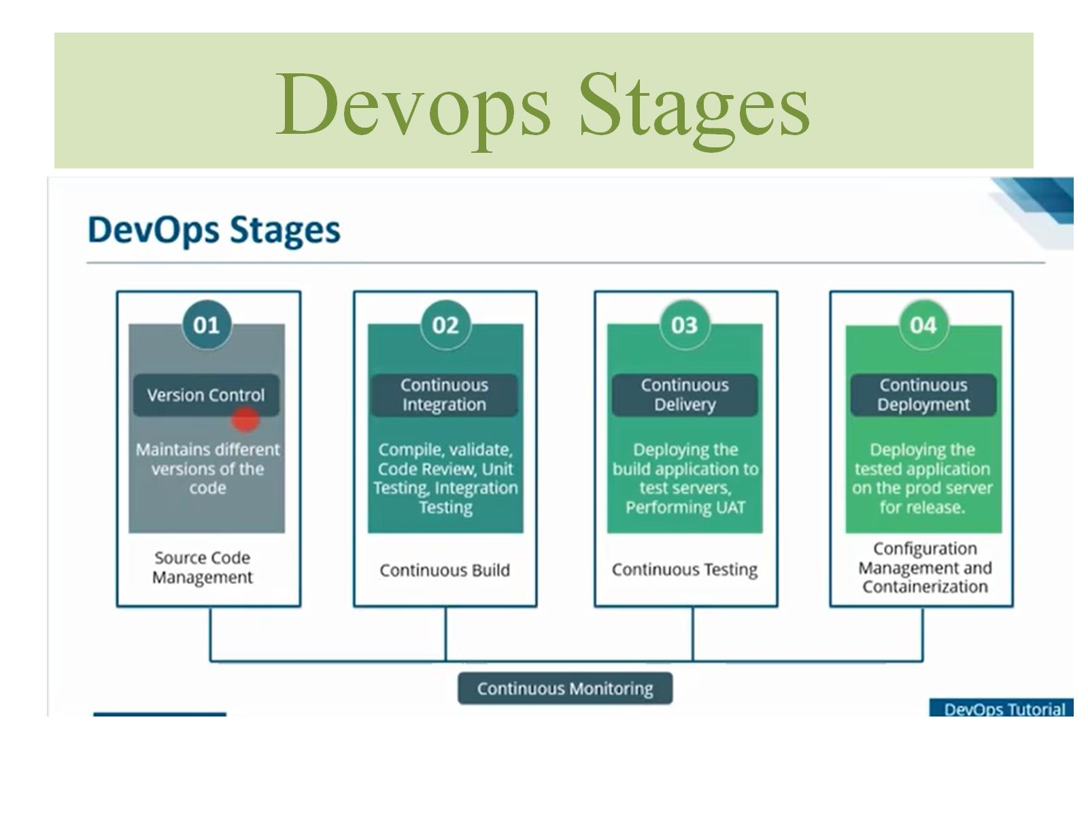
Devops Stages

Slide 9
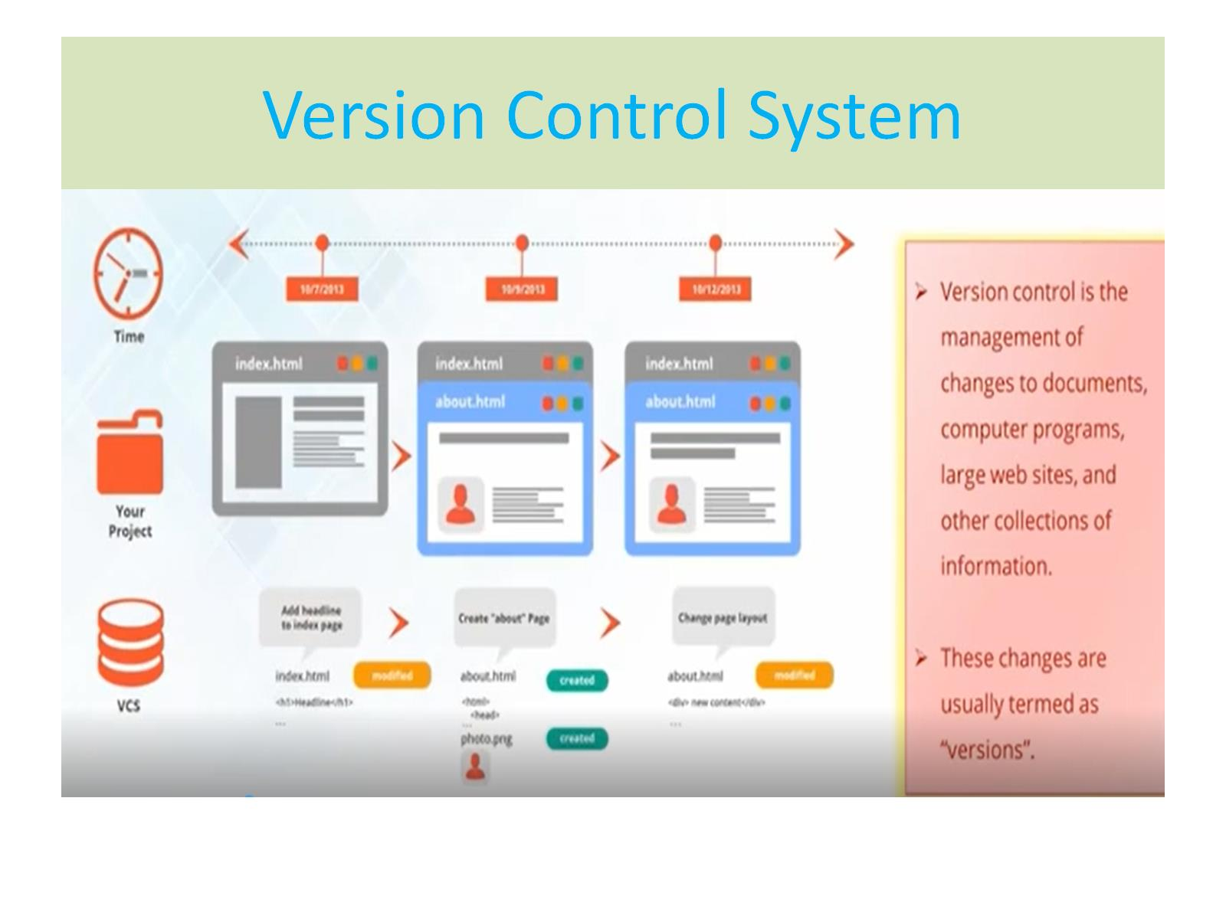
Version Control System

Slide 10
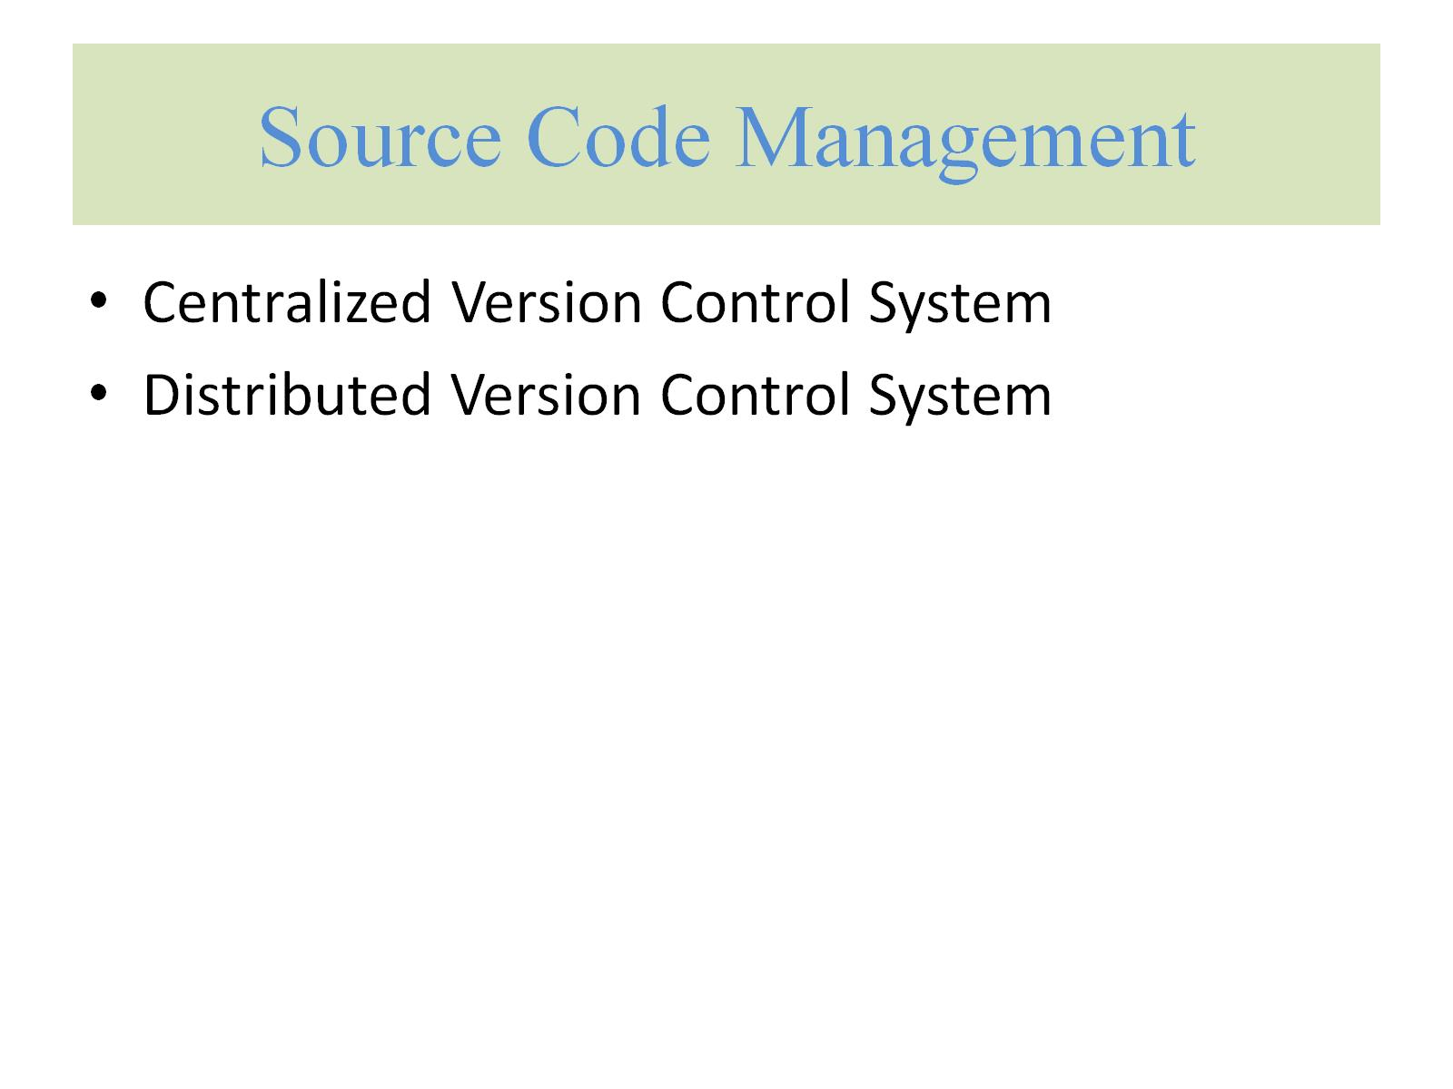
Source Code Management

Slide 11
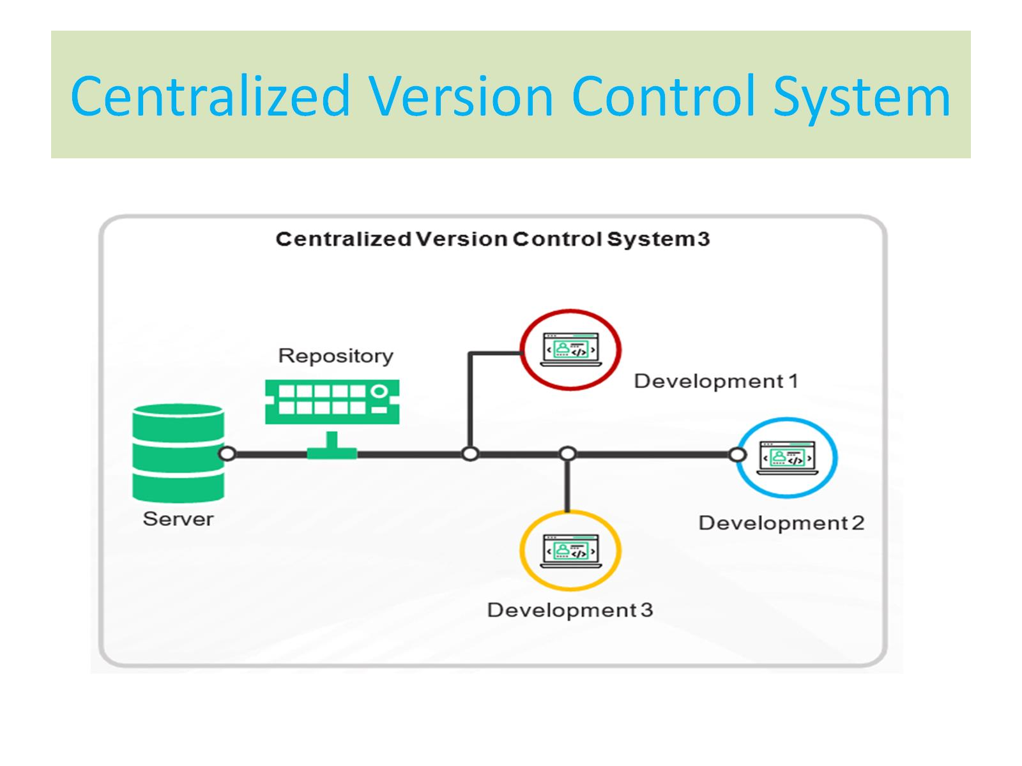
Centralized Version Control System

Slide 12
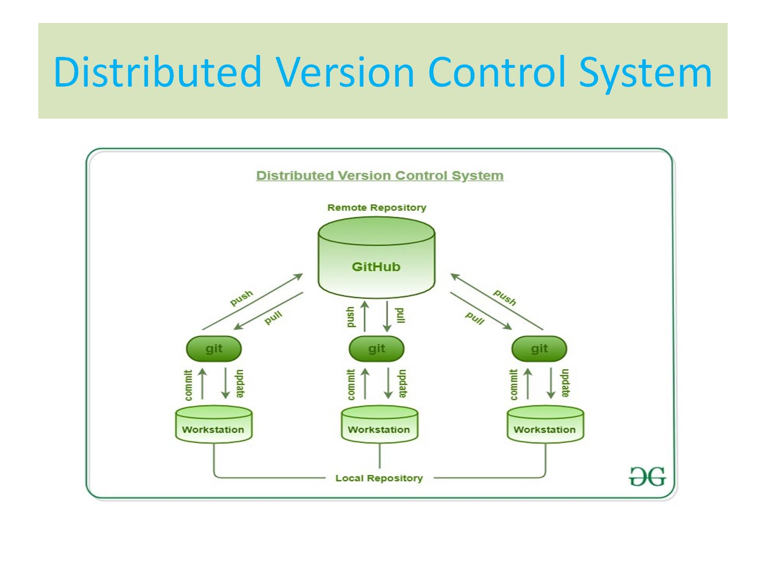
Distributed Version Control System

Slide 13
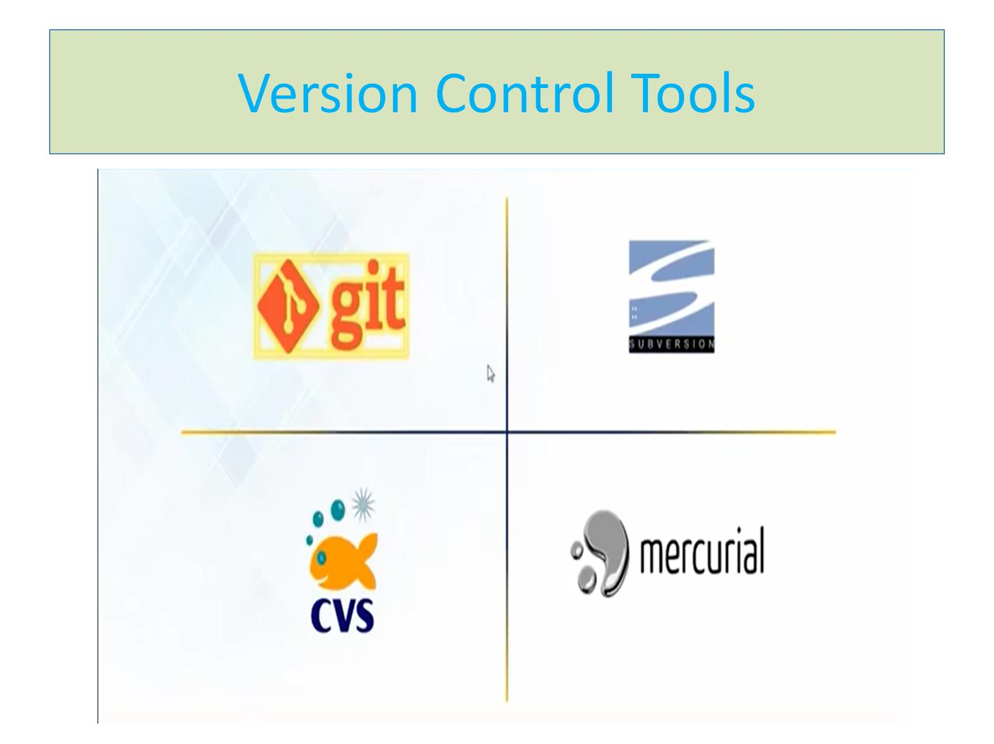
Version Control Tools

Slide 14
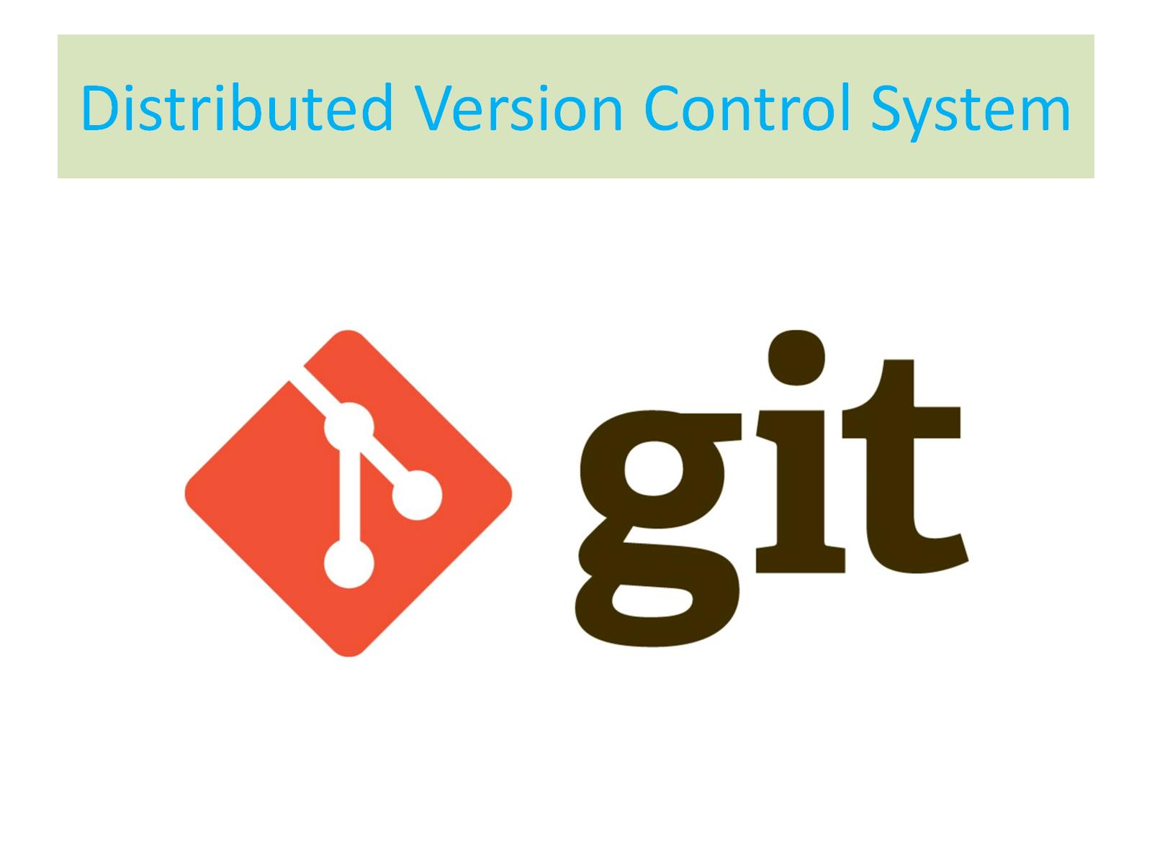
Distributed Version Control System

Slide 15
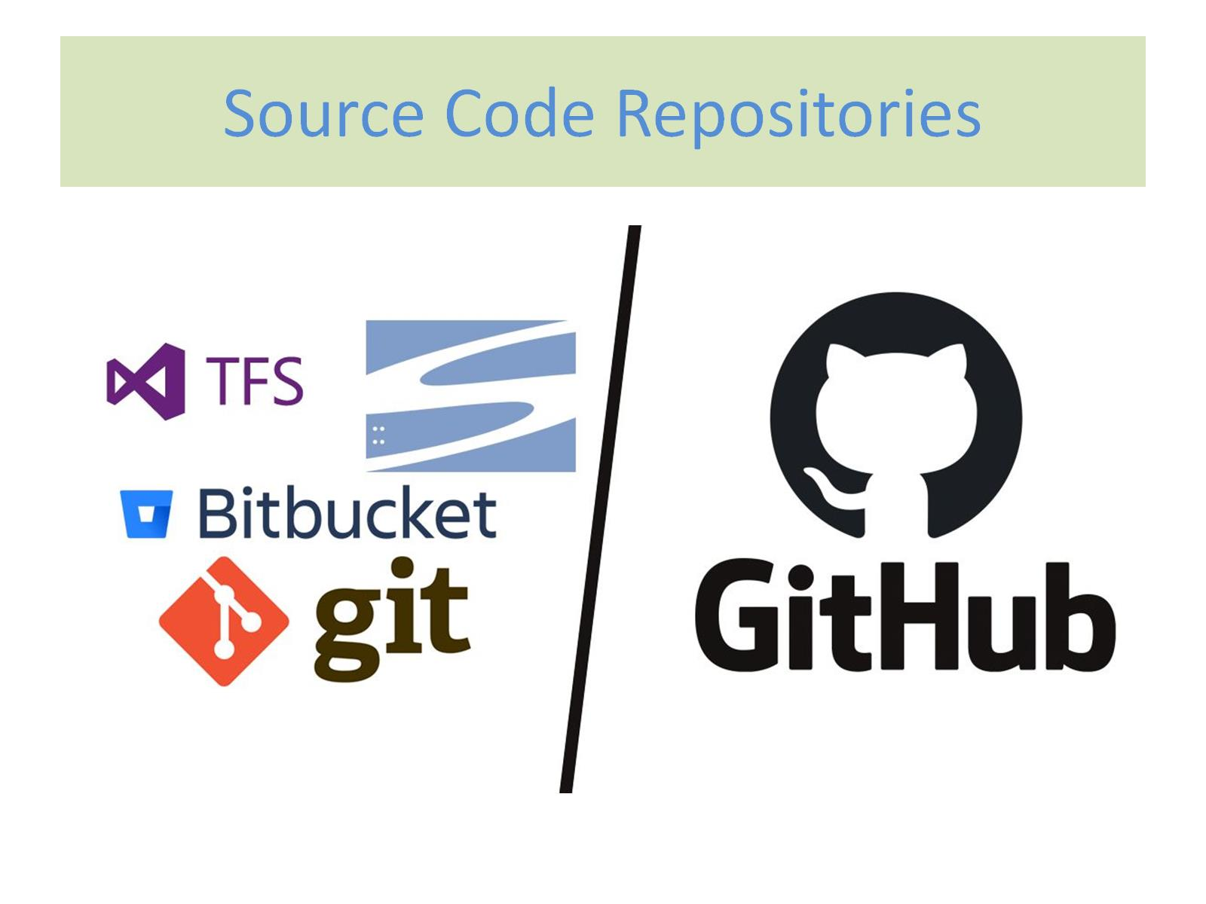
Source Code Repositories

Slide 16
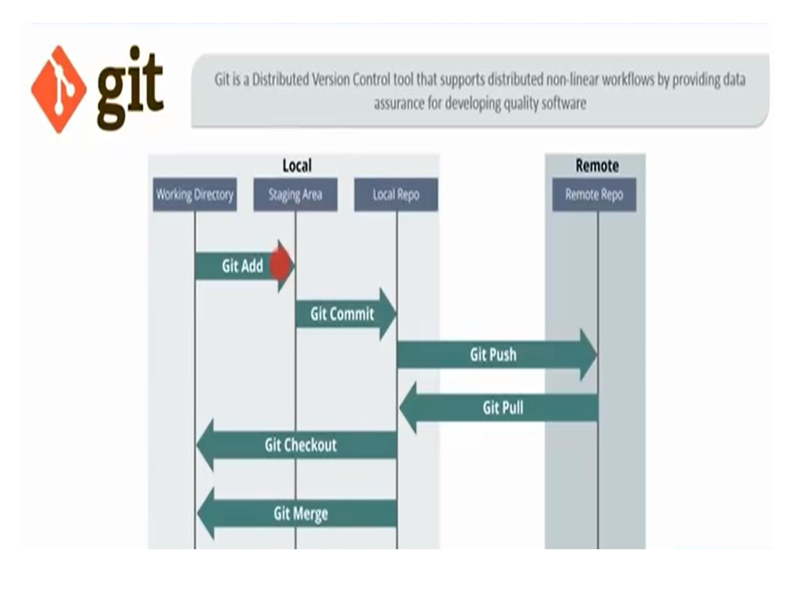
Git

Slide 17
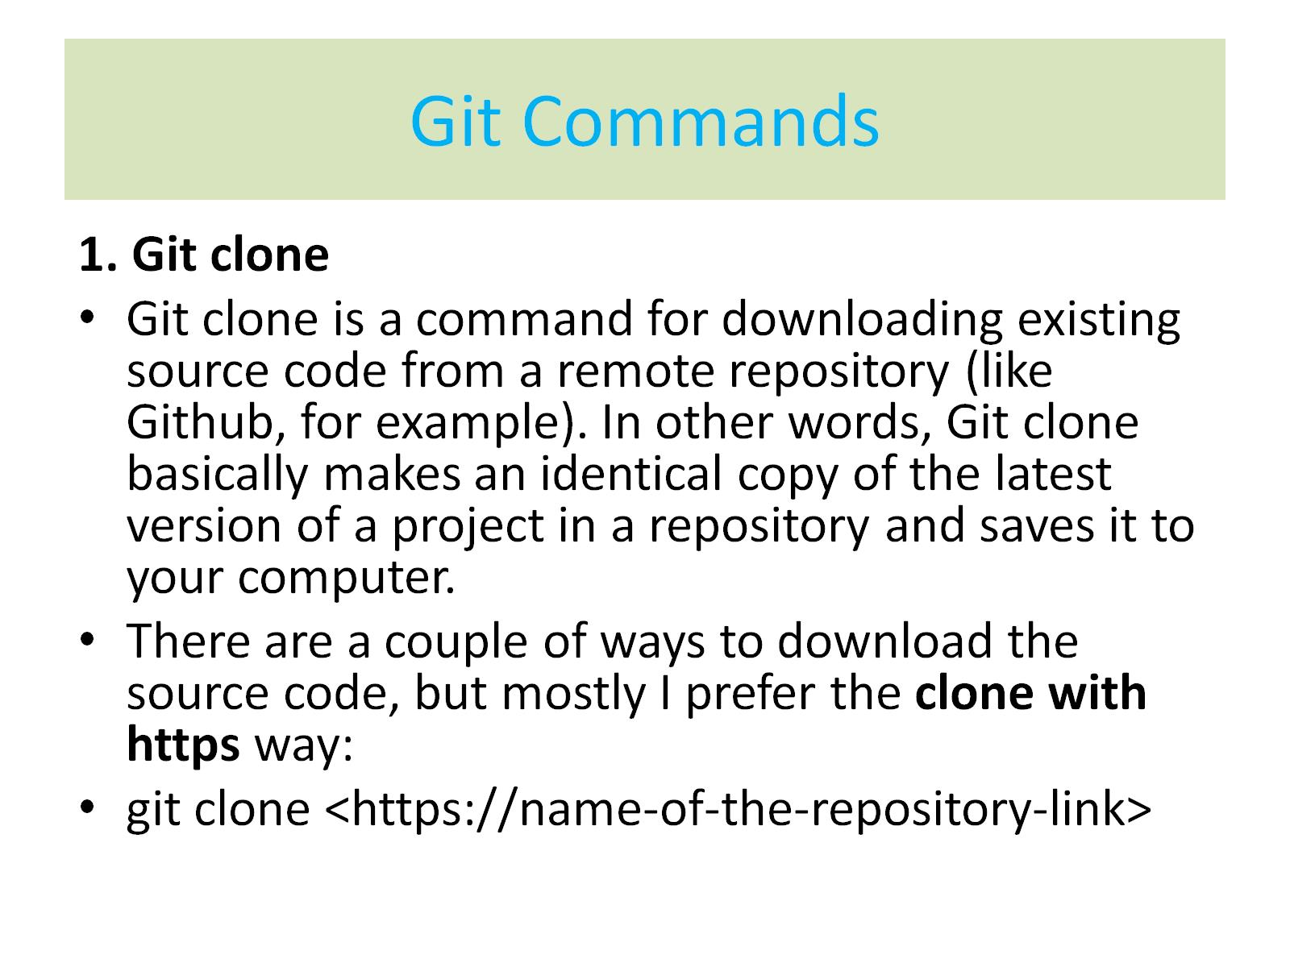
Git Commands

Slide 18
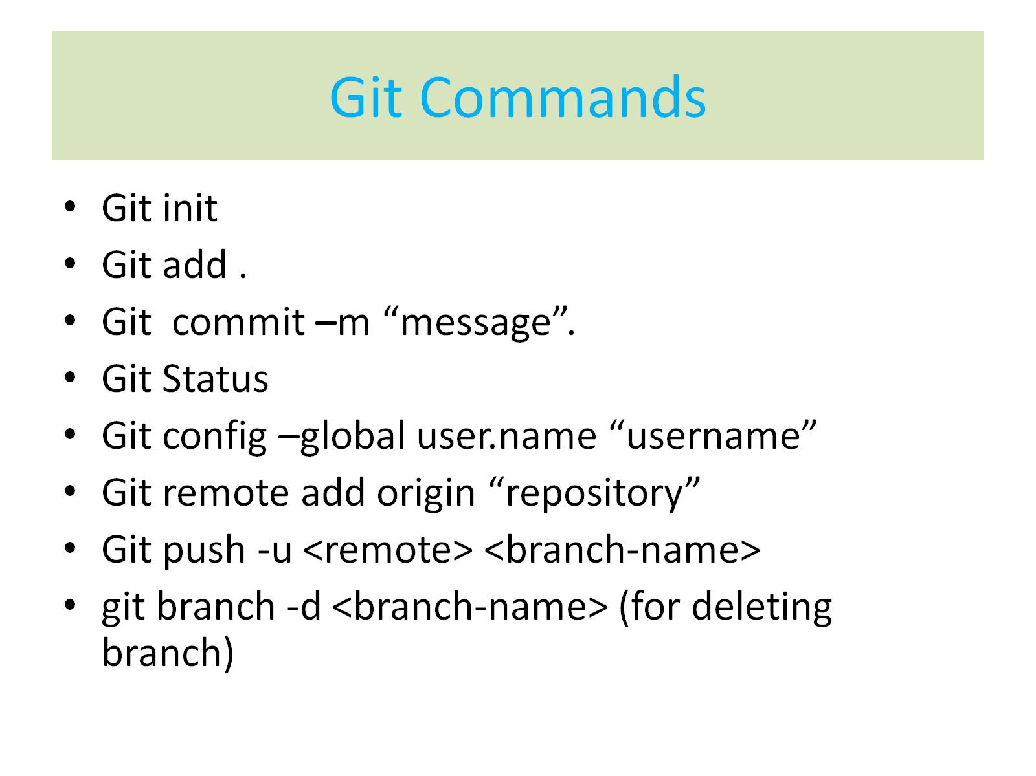
Git Commands

Slide 19
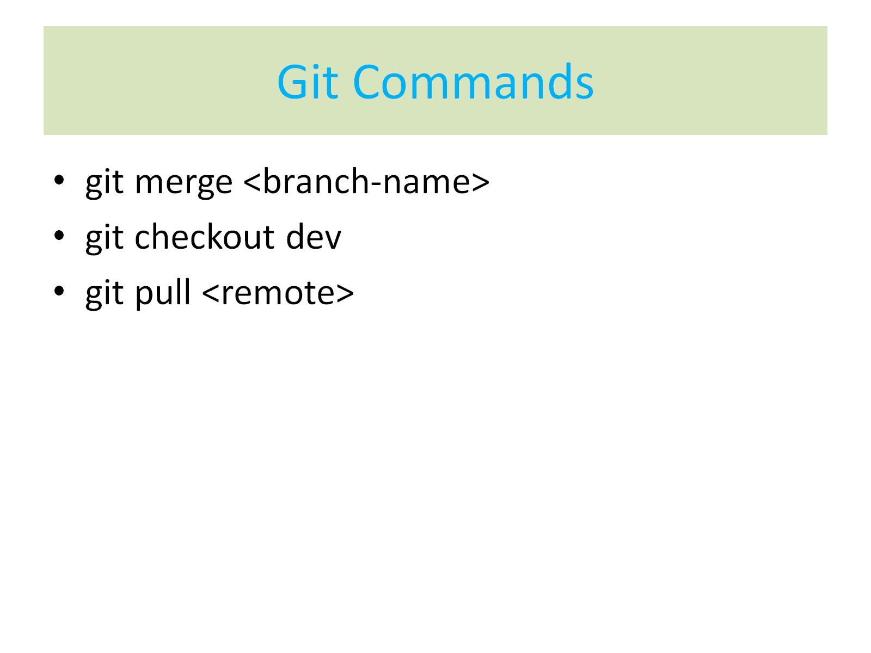
Git Commands

Slide 20
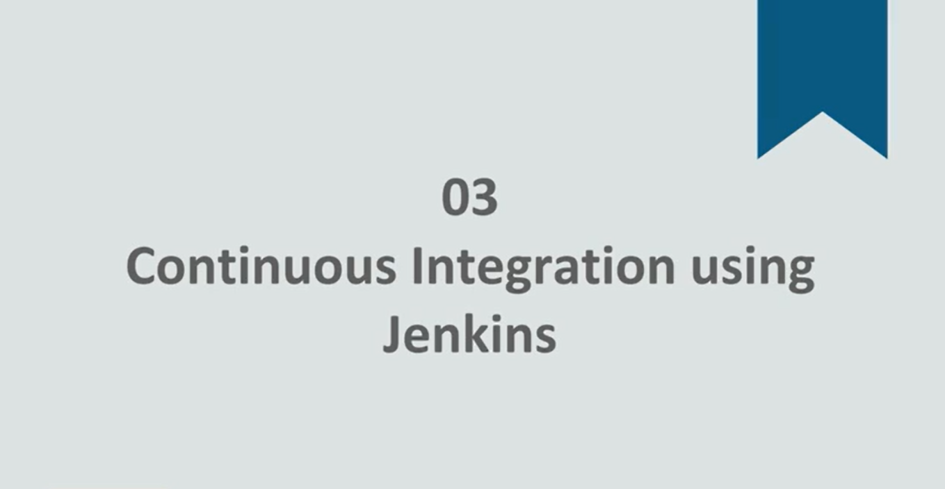
CI/CD

Slide 21
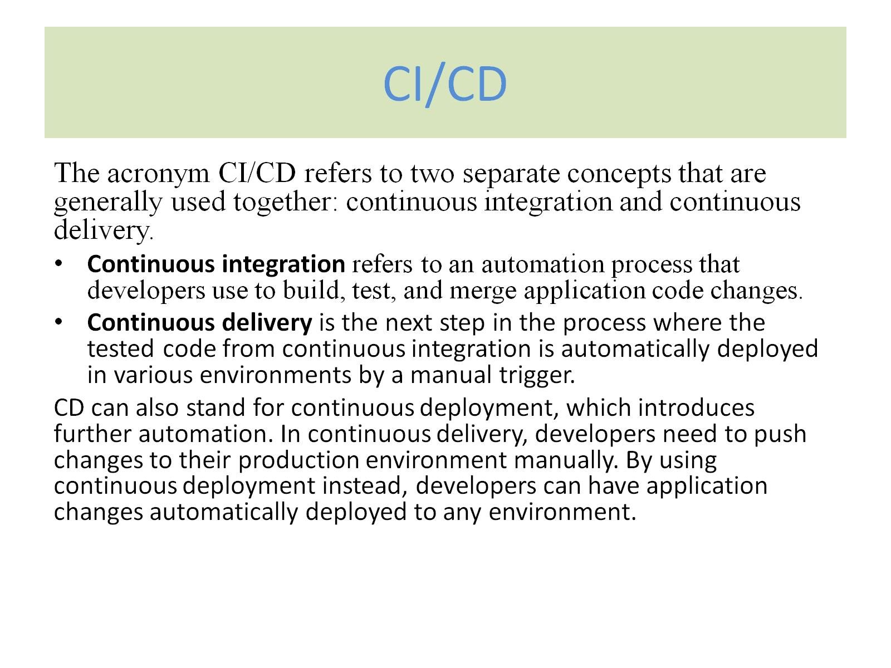

Slide 22
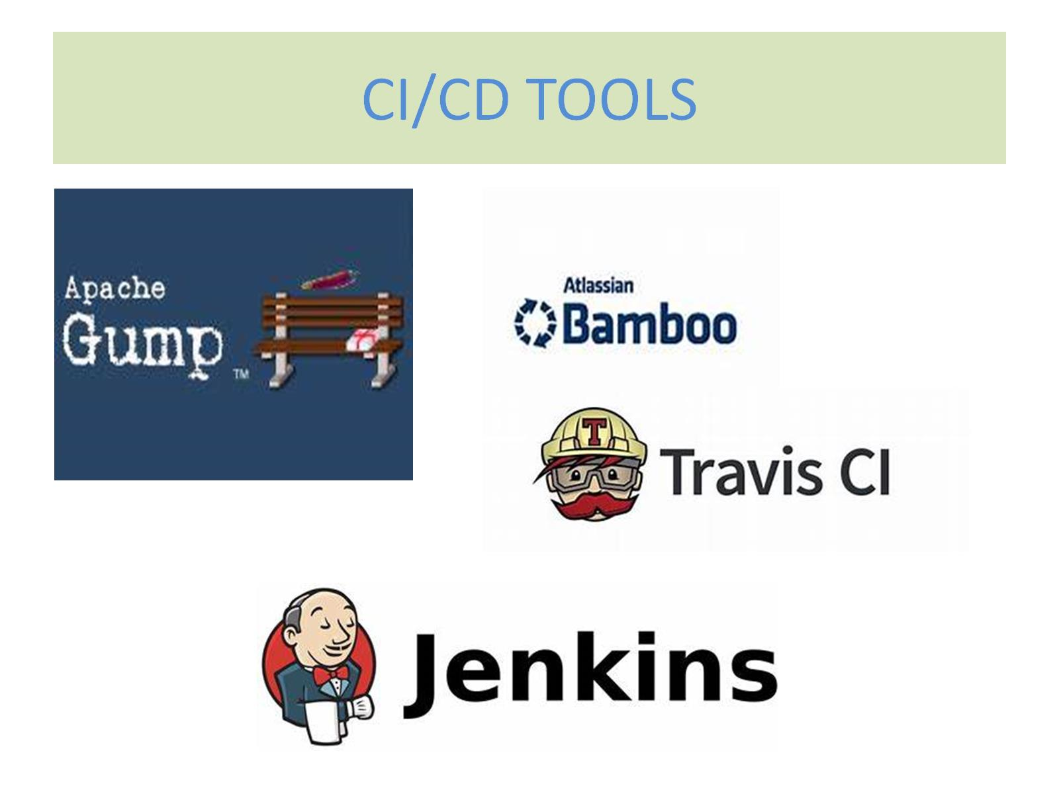

Slide 23
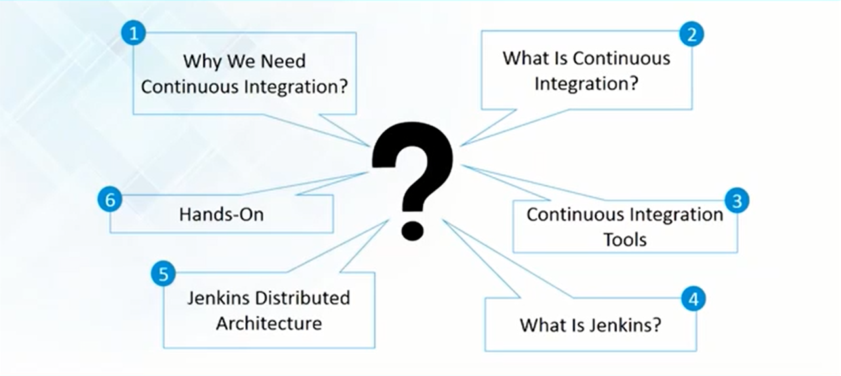

Slide 24
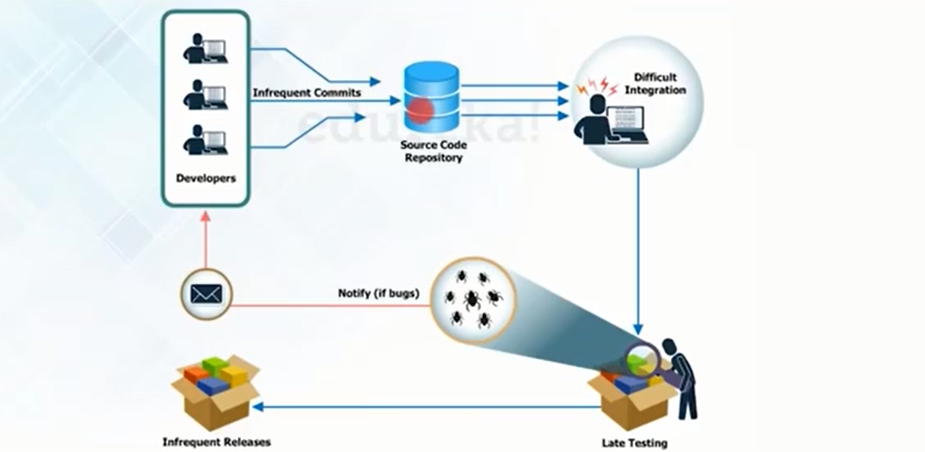
Process before Jenkins

Slide 25
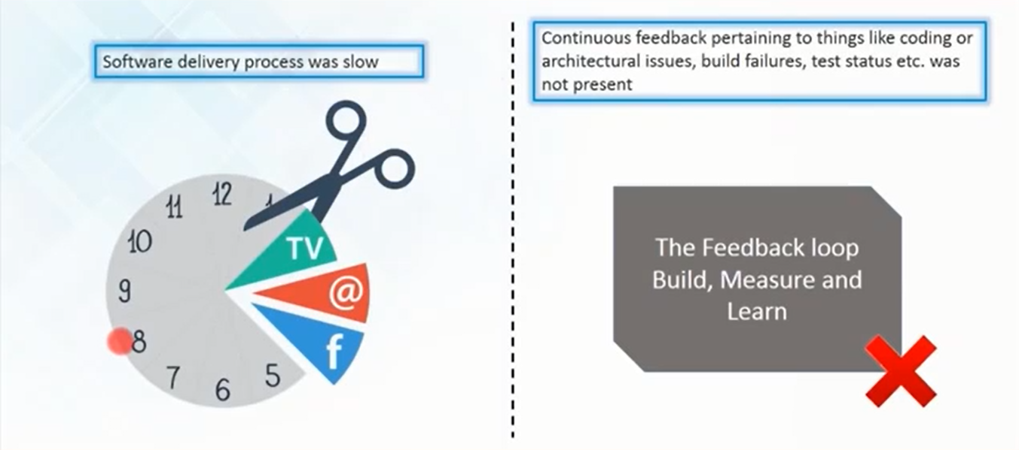
Problems before using Jenkins

Slide 26
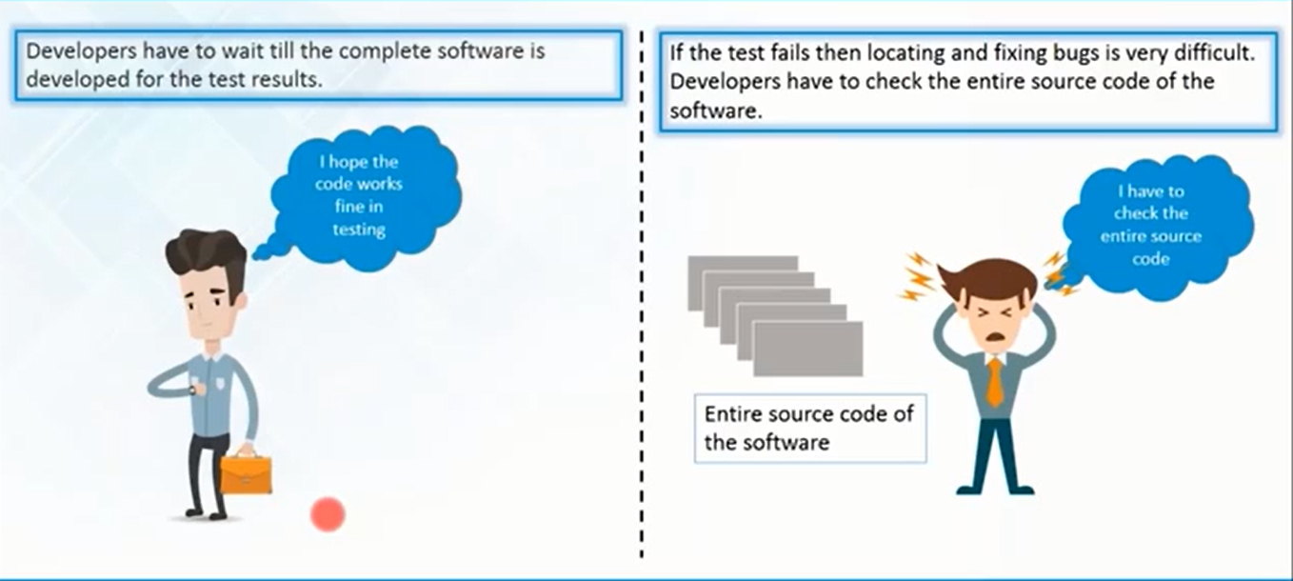
Problems before using Jenkins

Slide 27


Slide 28
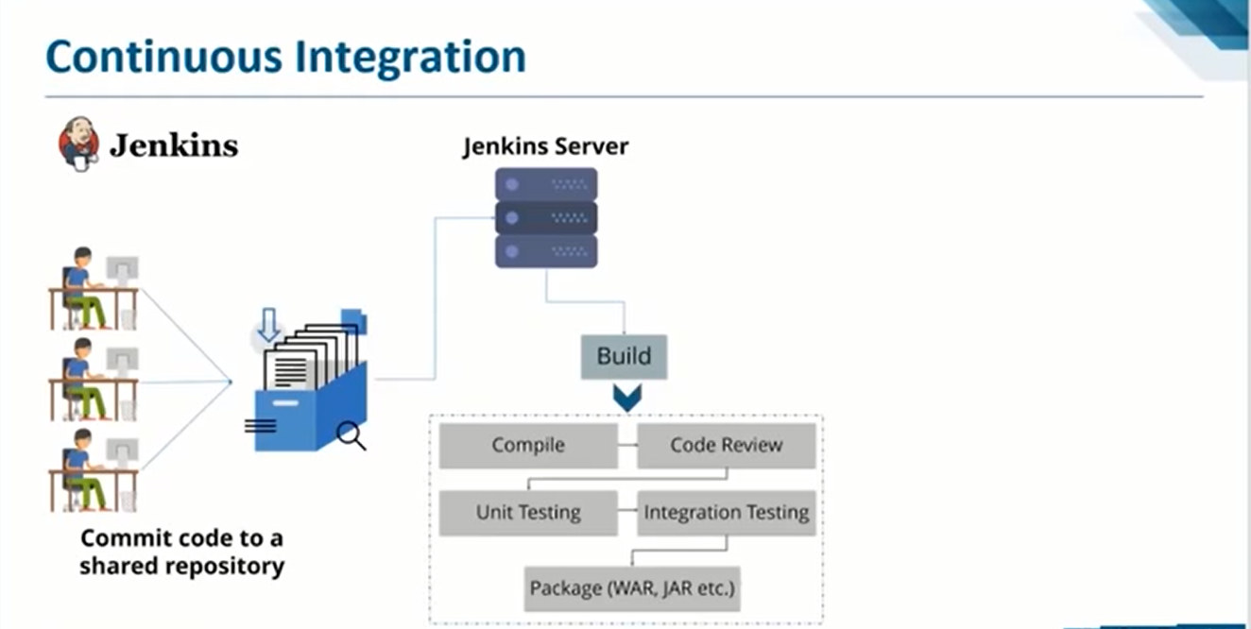

Slide 29
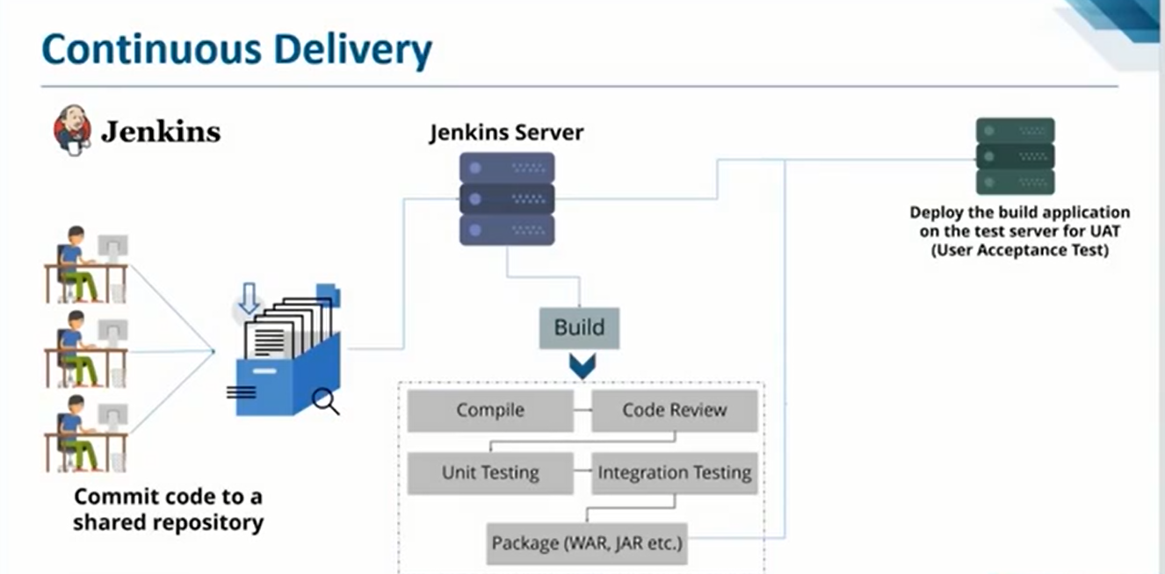

Slide 30
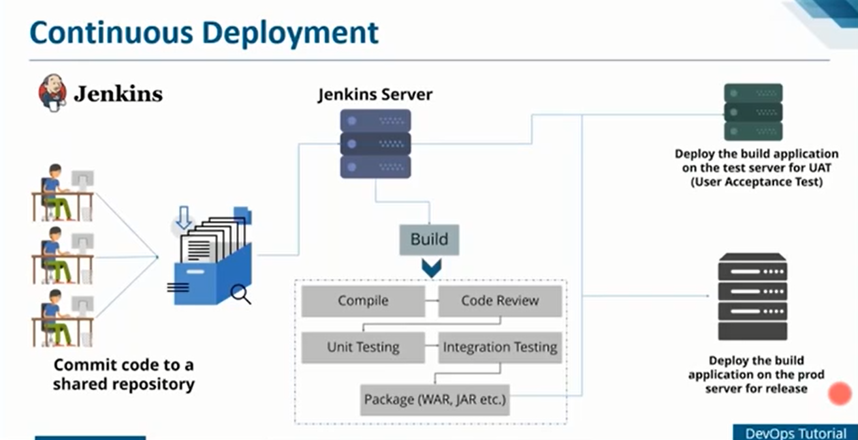

Slide 31
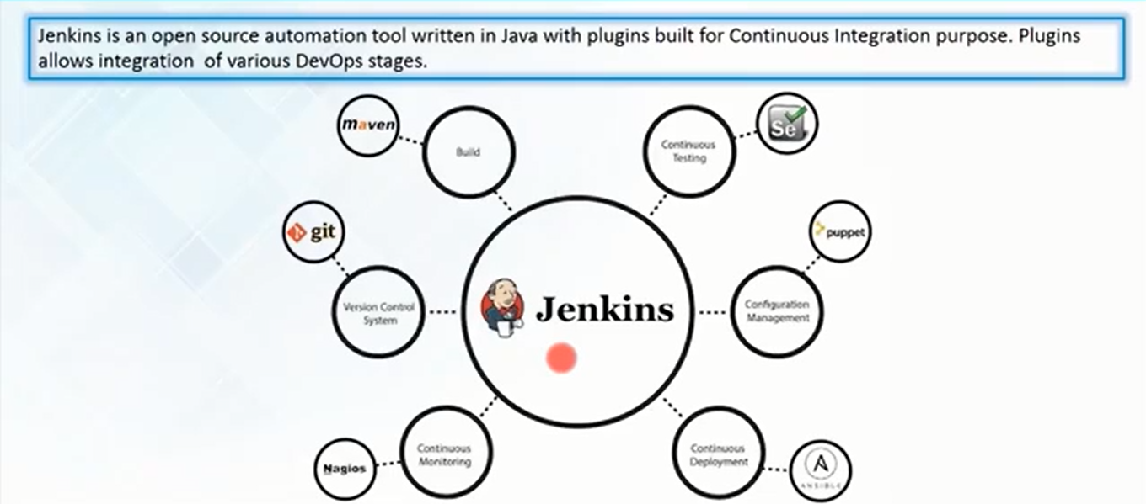

Slide 32
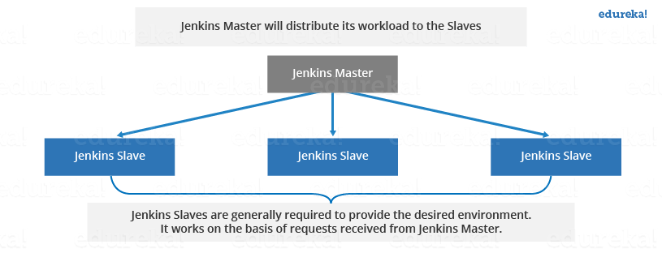
Jenkins Slave

Slide 33
JenkinsSlaves Jenkins is an awesome Continuous Integration tool which allows you to add multiple slaves as per your project requirement to a central Master server. In distributed environment, we need different machines for different purposes. For example, we may need machine1(Ubuntu) to run some process and machine2(CentOS) to run some other process. For such distribution, Jenkins Master Slave configuration comes to the rescue.

Slide 34
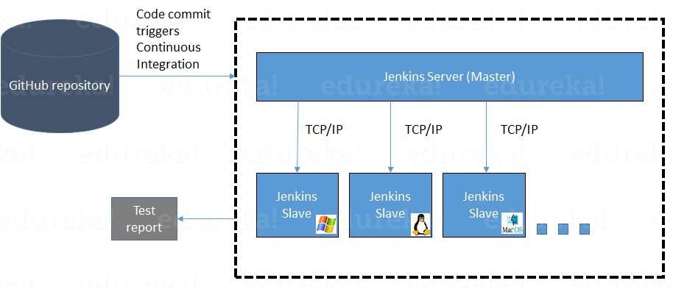
Distribute Slave Architecture

